Slide 1
Cross-Selling Data Analysis
<Virtual Internship>
<20-Sep-2023>

Slide 2
Agenda
Problem Statement
General EDA
Further EDA
Recommendations

Slide 3



Problem Statement
Background: XYZ, a US-based private firm, intends to explore investment opportunities in Cab Industry, which has experienced remarkable growth recently. As part of their Go-to-Market (G2M) strategy, they aim to gain comprehensive market insights before making any final decisions.
Objective : Leverage data to provide actionable business insights for XYZ firm, supporting their decision-making on which cab company to invest.

Slide 4




Approach
Data Preprocessing
Hypothesis Generation
Explorative Data Analysis
Data Visualization

Slide 5
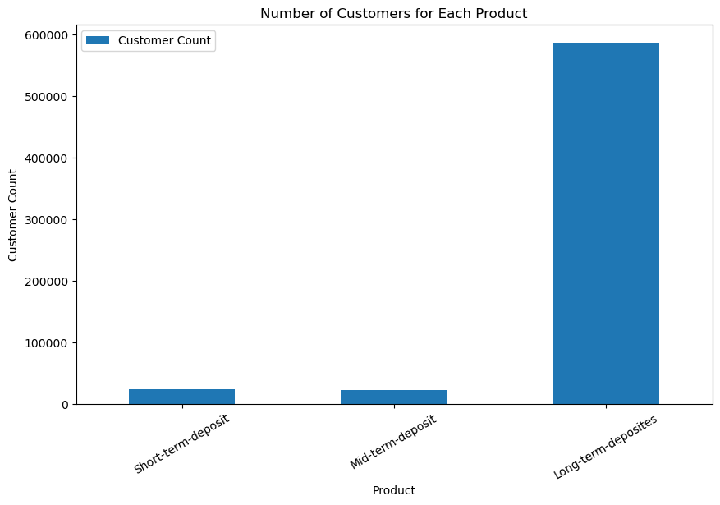
General EDA for different products
For short-term, mid-term and long-term deposit, the long-term deposit outrages the other two

Slide 6
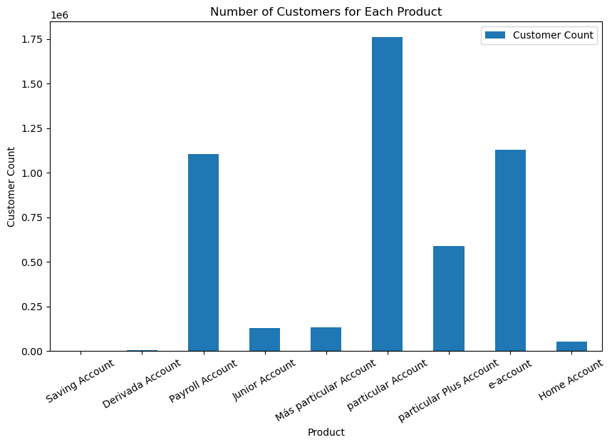

General EDA for different products
For bank account products, the Payroll account and e-account have largest number of users.

Slide 7
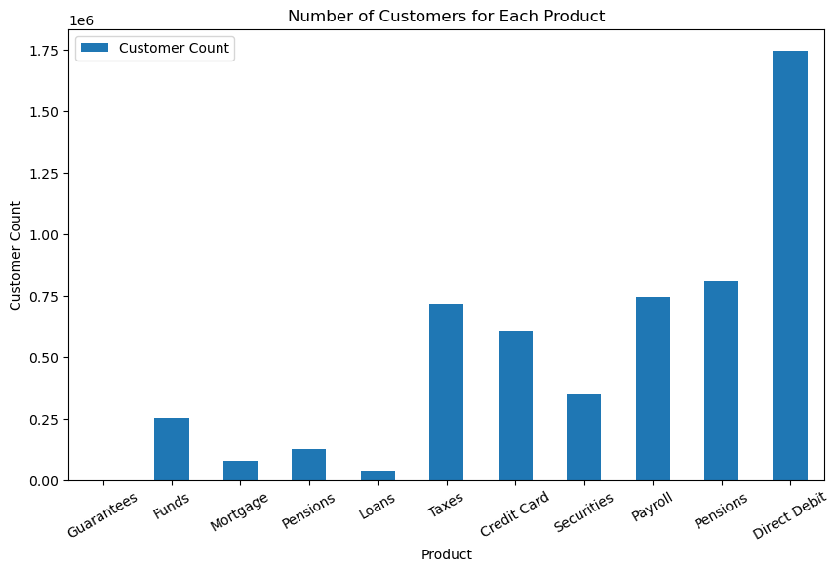

General EDA for different products
For bank services product, Direct Debit has largest number of user.

Slide 8
Further Analysis
Based on previous analysis, we have selected 4 most popular products for further analysis. The purpose for this is to paint a ’User portrait’ (identifying features of customers).

Slide 9
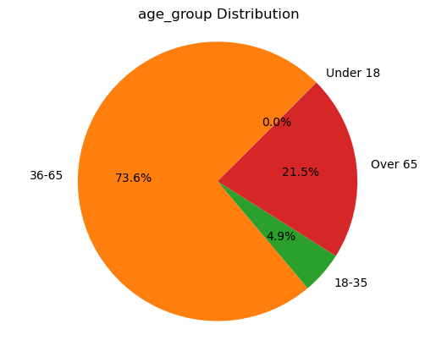
Long-term Deposit
Age group 36-65, and over 65 years old are the largest age group choosing long-term deposit

Slide 10
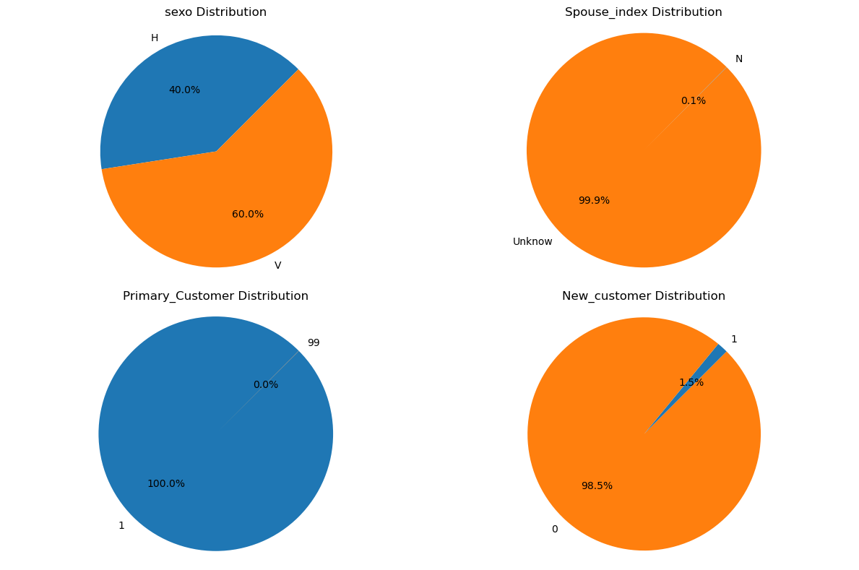
Long-term Deposit

Slide 11
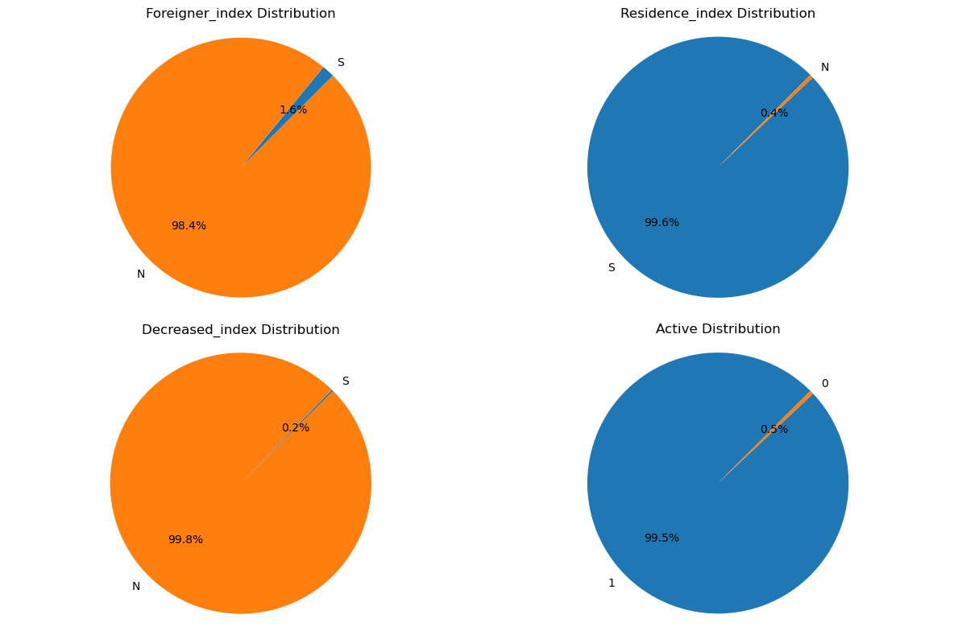
Long-term Deposit

Slide 12
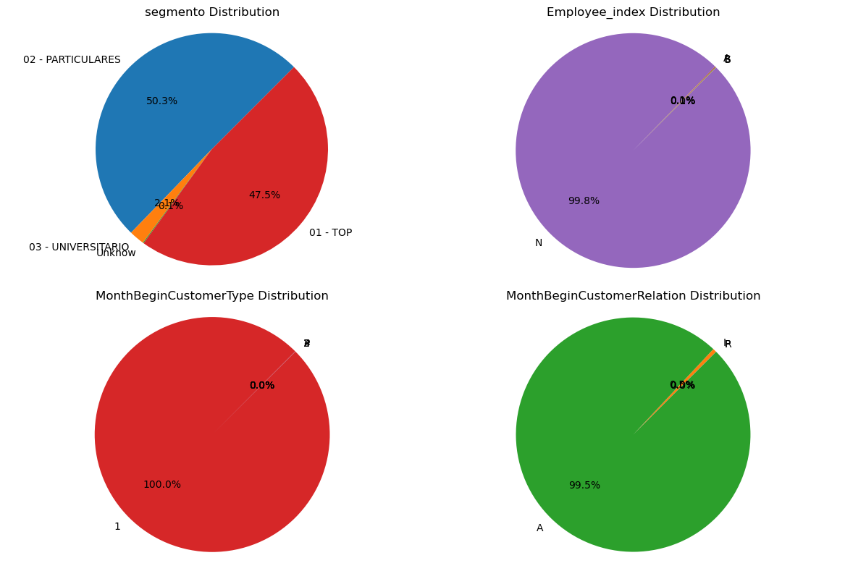
Long-term Deposit

Slide 13
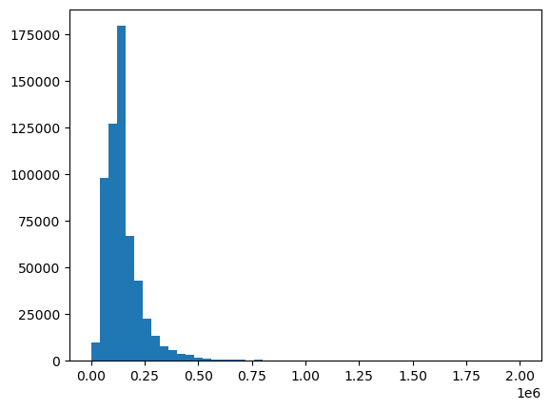
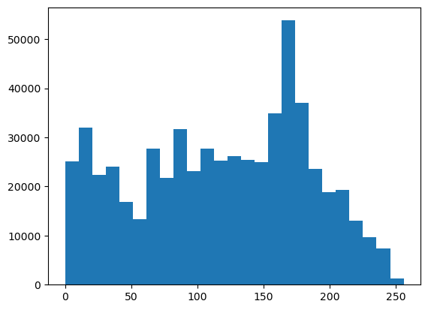
Long-term Deposit
Gross Income Distribution
Customer Seniority Distribution

Slide 14
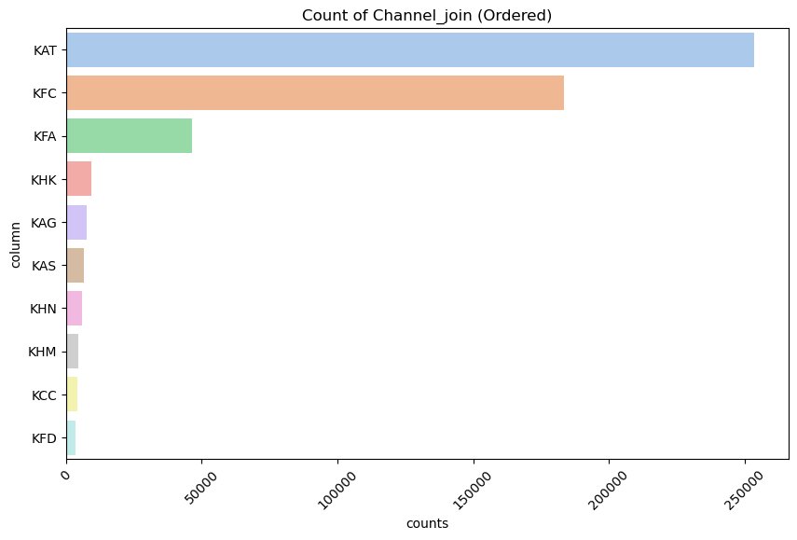
Long-term Deposit
Customers from
KAT, KFC and KFA should be our target

Slide 15
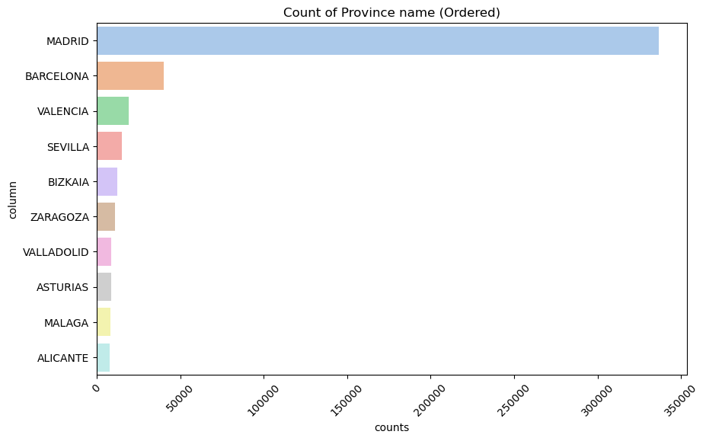
Long-term Deposit
Customers from Madrid, Barcelona and Valencia should be our target

Slide 16
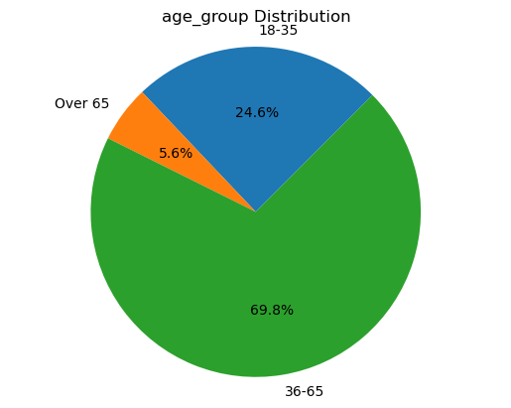
Payroll Account
Age group 18-35, and 36-65 years old are the largest age group choosing long-term deposit

Slide 17
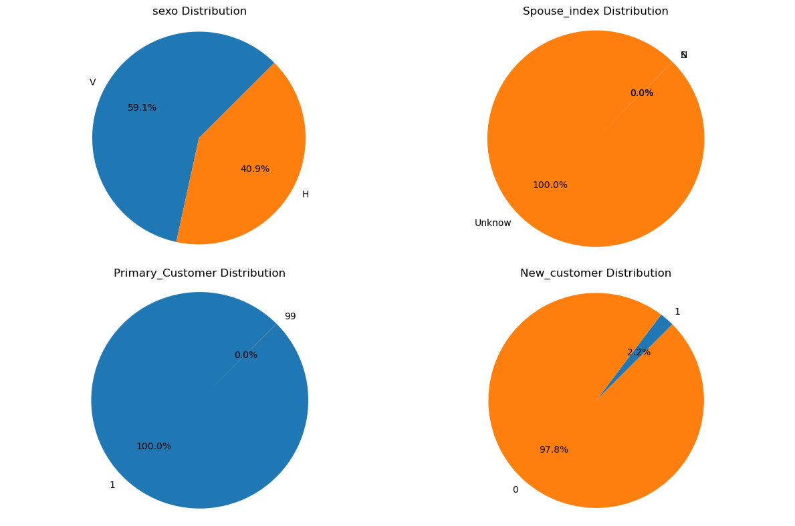
Payroll Account

Slide 18
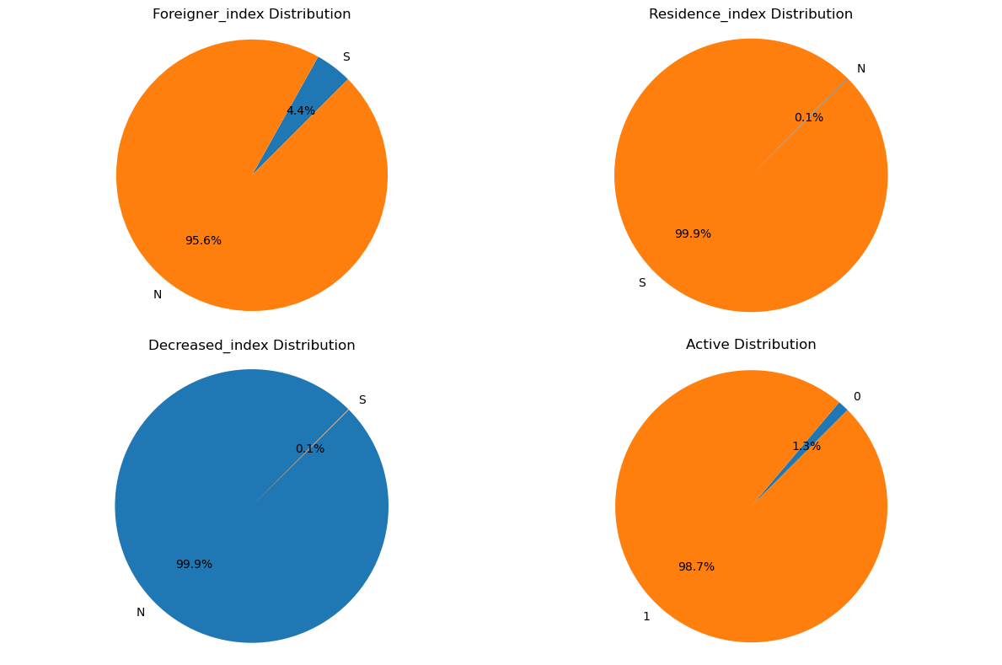
Payroll Account

Slide 19
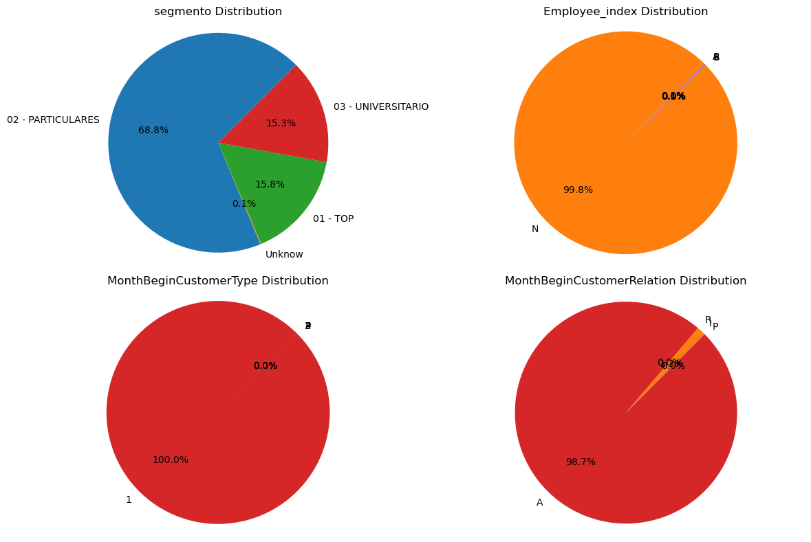
Payroll Account

Slide 20
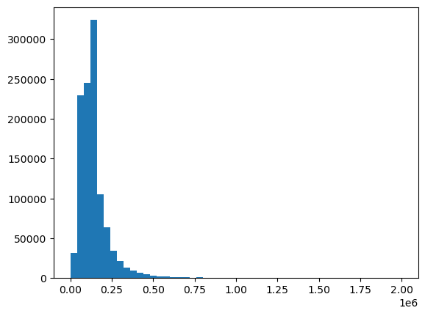
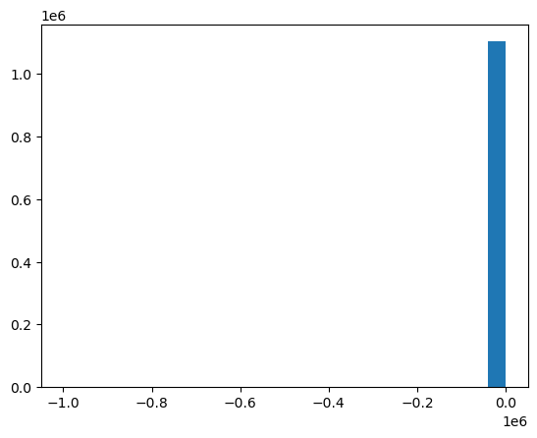
Payroll Account
Gross Income Distribution
Customer Seniority Distribution

Slide 21
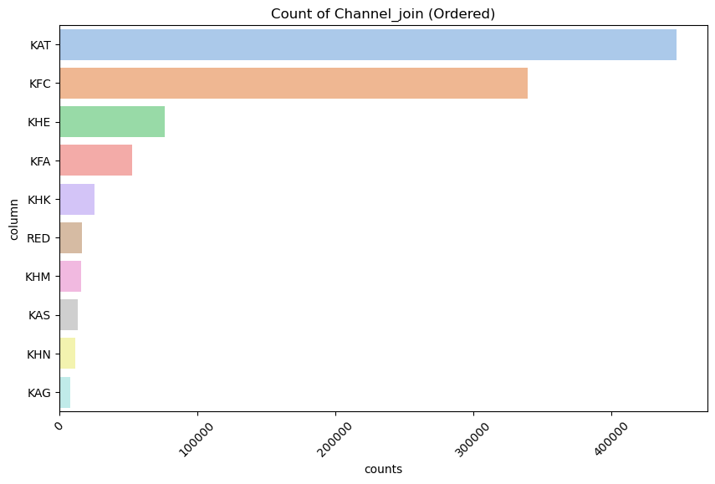
Payroll Account
Customers from
KAT, KFC, KHE and KFA should be our target

Slide 22
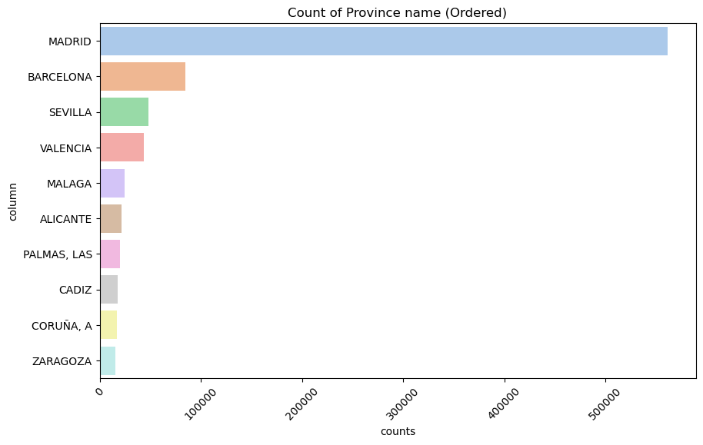
Payroll Account
Customers from Madrid, Barcelona, Sevilla, and Valencia should be our target

Slide 23
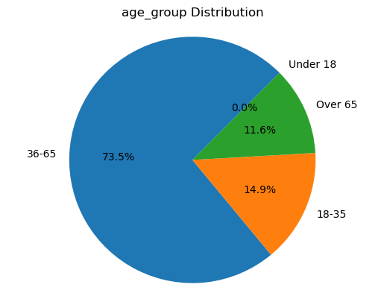
E-Account
Age group 36-65 years old are the largest age group choosing long-term deposit

Slide 24
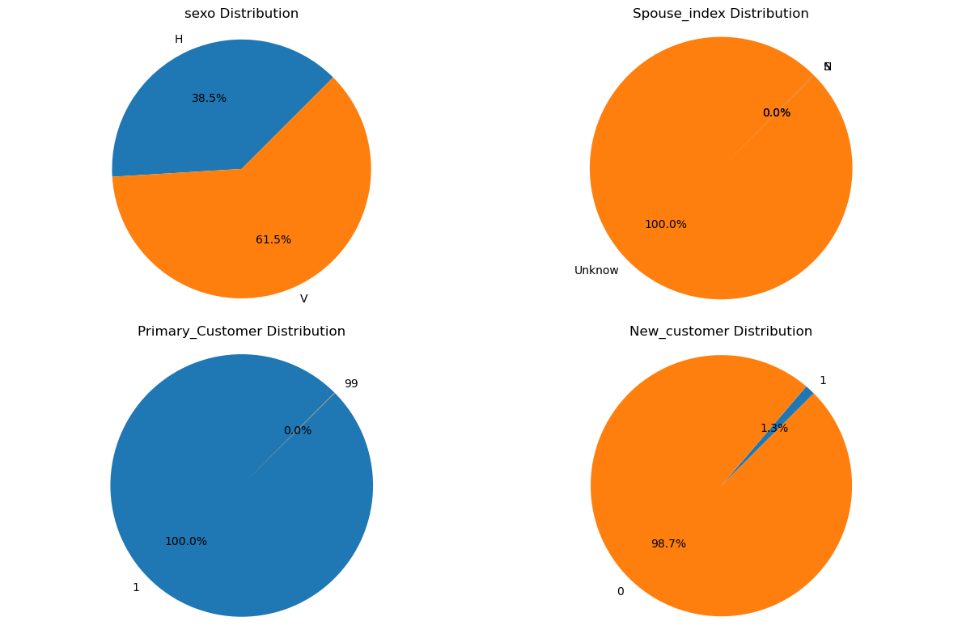
E-Account

Slide 25
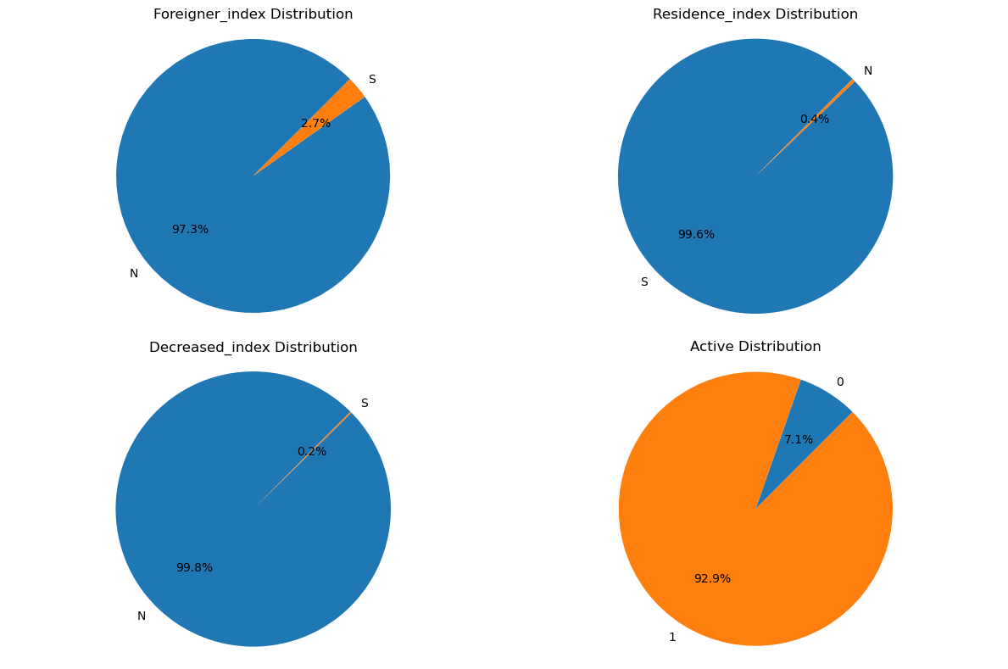
E-Account

Slide 26
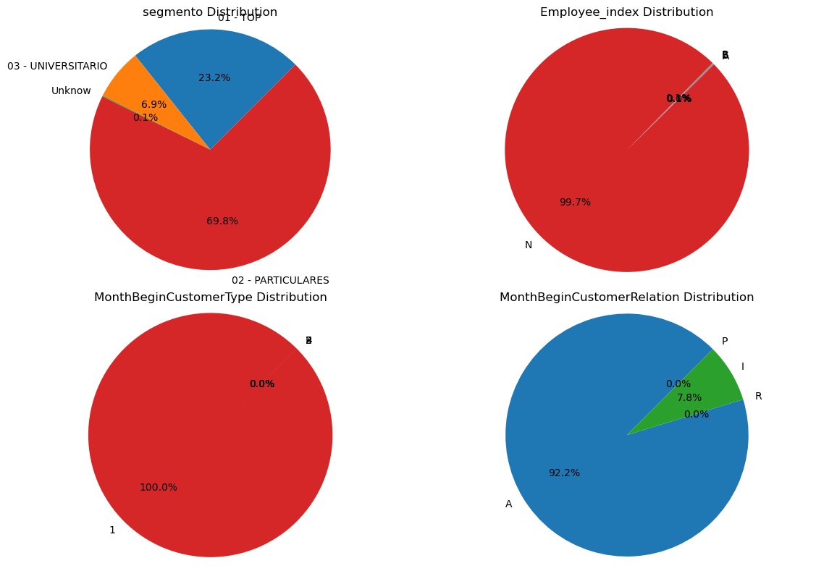
E-Account

Slide 27

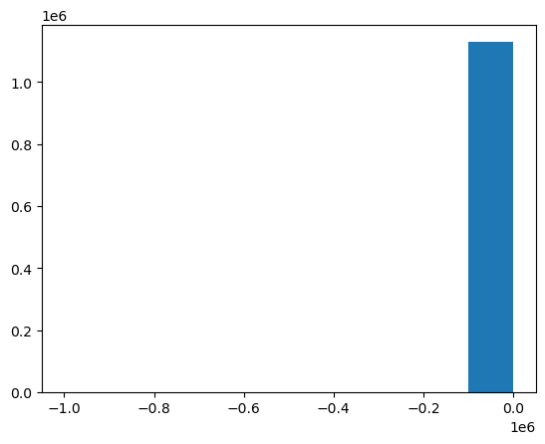
E-Account
Gross Income Distribution
Customer Seniority Distribution

Slide 28
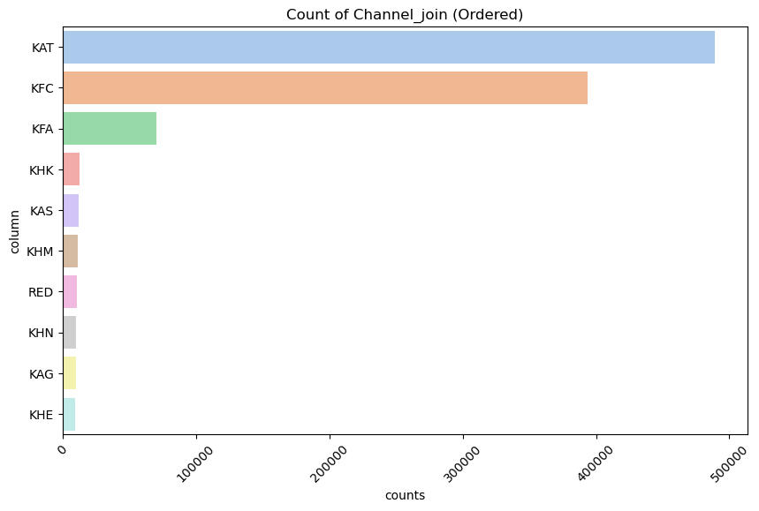
E-Account
Customers from
KAT, KFC and KFA should be our target

Slide 29
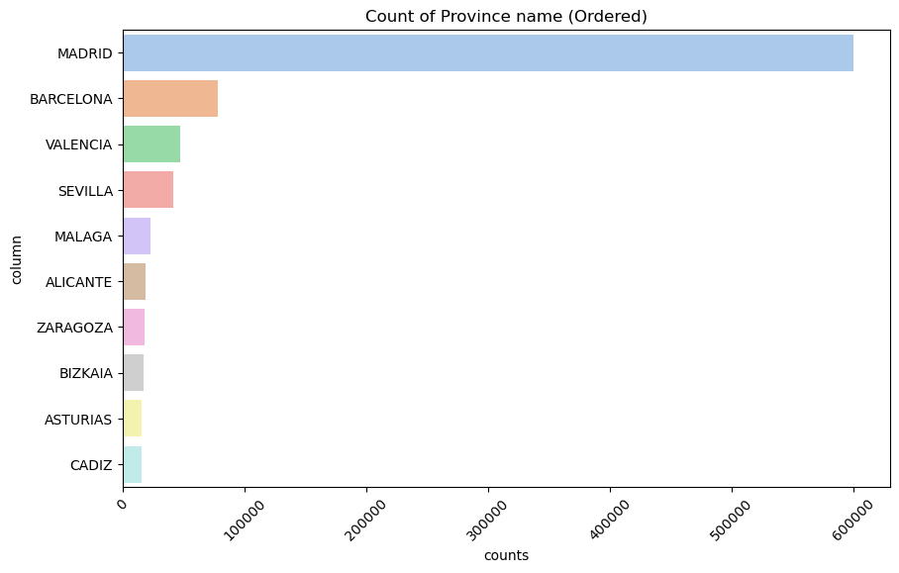
E-Account
Customers from Madrid, Barcelona, and Valencia should be our target

Slide 30
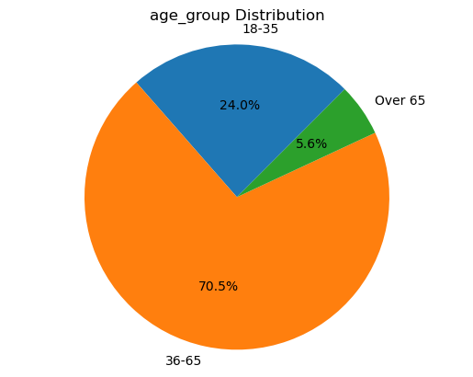
Direct Debit
Age group 36-65 years old are the largest age group choosing long-term deposit

Slide 31
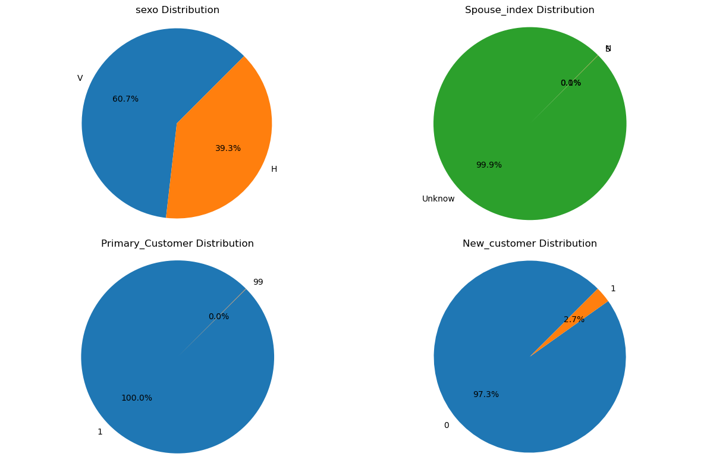
Direct Debit

Slide 32
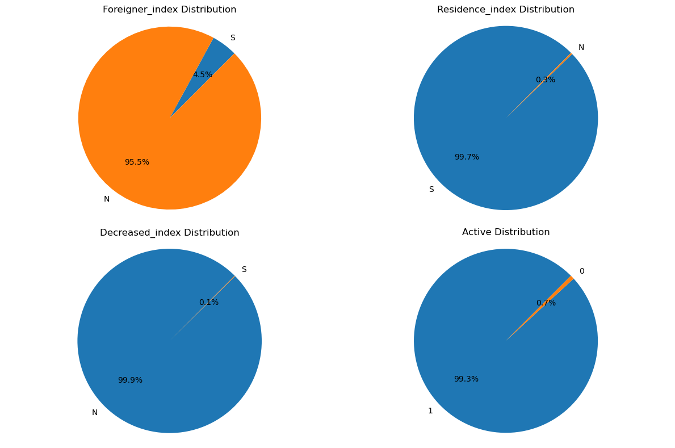
Direct Debit

Slide 33
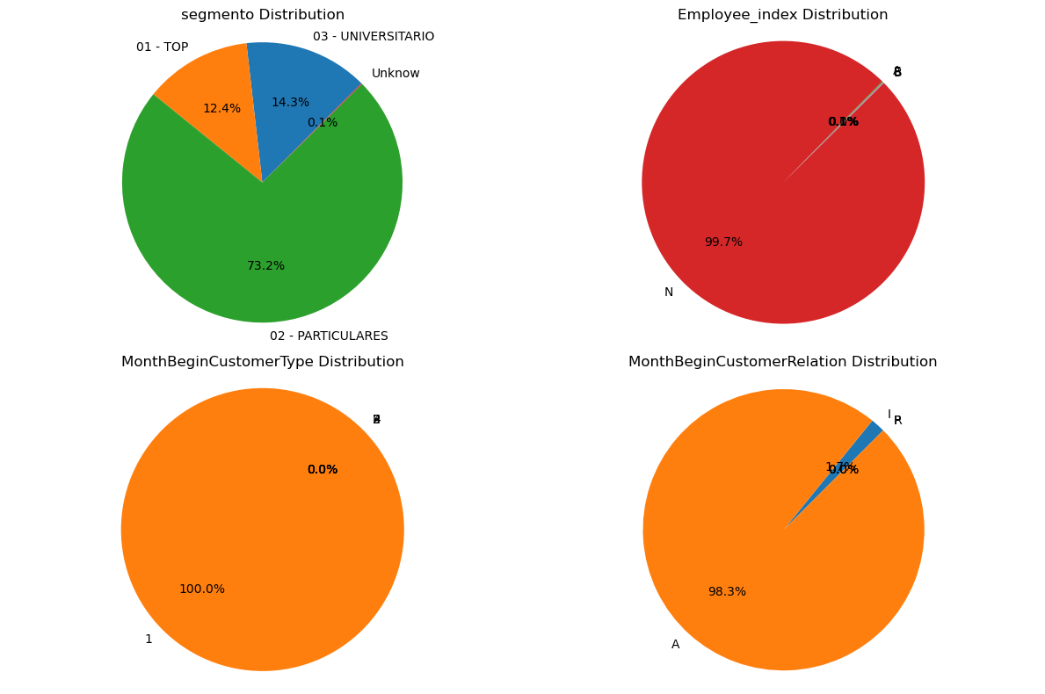
Direct Debit

Slide 34
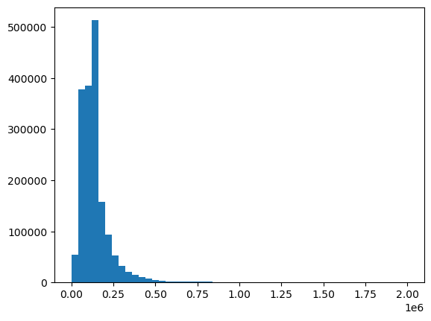
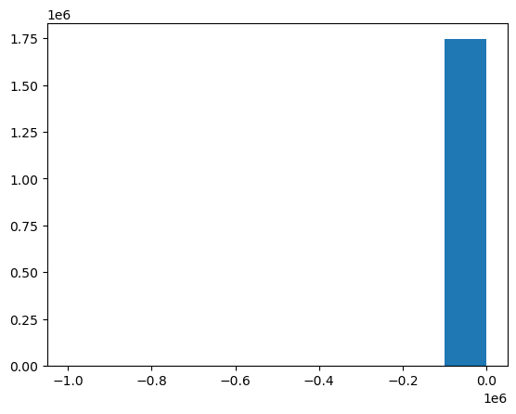
Direct Debit
Gross Income Distribution
Customer Seniority Distribution

Slide 35
Direct Debit
Customers from
KAT, KFC and KHE should be our target

Slide 36
Direct Debit
Customers from Madrid, Barcelona, and Sevilla should be our target

Slide 37
EDA Summary
The exploratory data analysis reveals valuable insights:
Dominant products
Product based Customer analysis
Cross-selling insights on target customers

Slide 38
Thank You

Slide 39
Recommended Model: GBM
Robustness to Outliers and Irregularities: GBM can handle noises and outliers the dataset without compromising its performance.
Feature Importance Analysis: GBM provides insights into feature importance, helping us understand the most influential variables in our data.
Handling Mixed Data Type: GBM can effectively handle mixed data types, including both numeric and categorical variables.
Efficiency on Large Datasets: GBM implementations like XGBoost is designed to be memory-efficient and capable of handling large datasets with millions of observations.

